Slide 1
BFO-SCO-UFO
SCO V1.0.0. Alignment
to
Unified Foundational Ontology (UFO)

Slide 2
Goal
The Sustainability Core Ontology (SCO) currently employs Basic Formal Ontology (BFO) as the upper-level ontology.
This work explores and sets directions for aligning SCO to other Top-Level Ontologies (TLOs), specifically the Unified Foundational Ontology (UFO).
UFO OWL version: gUFO.
Towards SCO V1.1.0.
SCO-B (B for BFO): alignment to BFO.
SCO-U (U for UFO): alignment to UFO.
Goal: to ensure SCO leverages and incorporates different ontological perspectives to establish a common reference hub for sustainability.

Slide 3
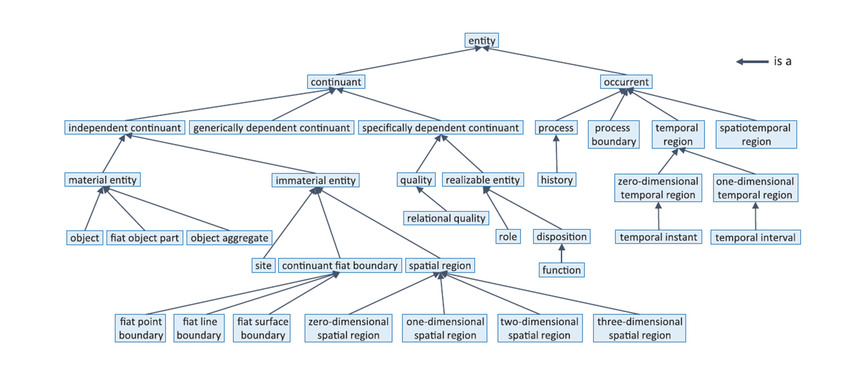
BFO
From ISO/IEC 21838-2:2021, 2021

Slide 4
UFO
From Guizzardi et al. (2022)

Slide 5
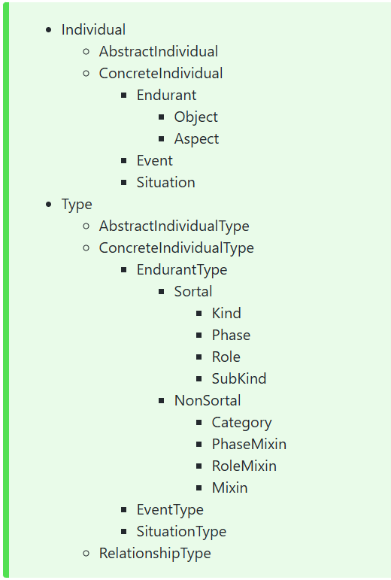
gUFO
From https://nemo-ufes.github.io/gufo/

Slide 6
Classes from which to start the alignment
Complex system.
Complex system component.
Interaction among complex system components.
Stakeholder.
Stakeholder role.
Perspective.
These are core SCO classes with regard to sustainability.

Slide 7
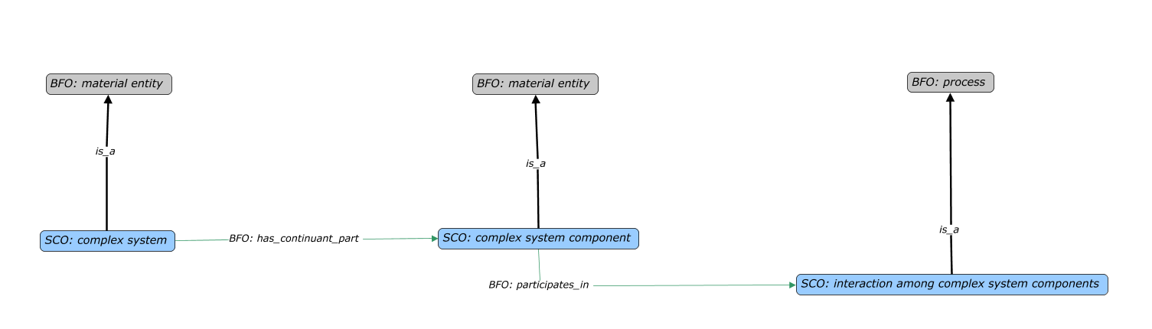
Example: Complex System, Components, and Interactions.
The SCO representation that is BFO compliant.

Slide 9
References
Arp, R., Smith, B., & Spear, A. D. (2015). Building ontologies with Basic Formal Ontology. Massachusetts Institute of Technology.
Guizzardi, G., Botti Benevides, A., Fonseca, C. M., Porello, D., Almeida, J. P. A., & Prince Sales, T. (2022). UFO: Unified Foundational Ontology. Applied Ontology, 17(1), 167–210. https://doi.org/10.3233/AO-210256
https://nemo-ufes.github.io/gufo/#concreteindividuals +ttl file.
COVER ttl file.

